Slide 1
Blacktown Chinese Christian Church
Welcome to Our English Service 26.10.2025
English Service 9:45 – 11:00 am
Worship Songs: Passage: Speaker: Topic: Response Song: Announcements and Closing Prayer Benediction
Ancient Of Days Good Good Father James 1:1-18 Jenny Williams The A B C of James TBA

Slide 2
BCCC english service

Slide 3

Please keep all phones on silent

Slide 4
Ancient Of Days
CCLI Licence No: 5485849

Slide 5
Though the nations rage, kingdoms rise and fall
There is still one King reigning over all
So I will not fear for this truth remains
That my God is, the Ancient of Days

Slide 6
None above Him, none before Him
All of time in His hands
For His throne it shall remain and ever stand

Slide 7
All the power, all the glory
I will trust in His name
For my God is, the Ancient of Days

Slide 8
Though the dread of night overwhelms my soul
He is here with me, I am not alone
O His love is sure, and He knows my name
For my God is, the Ancient of Days

Slide 9
None above Him, none before Him
All of time in His hands
For His throne it shall remain and ever stand

Slide 10
All the power, all the glory
I will trust in His name
For my God is, the Ancient of Days

Slide 11
Though I may not see what the future brings
I will watch and wait for the Saviour King
Then my joy complete standing face to face
In the presence of the Ancient of Days

Slide 12
None above Him, none before Him
All of time in His hands
For His throne it shall remain and ever stand

Slide 13
All the power, all the glory
I will trust in His name
For my God is, the Ancient of Days
For my God is, the Ancient of Days

Slide 14
Good Good Father
CCLI Licence No: 5485849

Slide 15
Oh I've heard a thousand stories of
What they think You're like
But I've heard the tender whisper of
Love in the dead of night

Slide 16
And You tell me that You're pleased
And that I'm never alone

Slide 17
You're a Good, Good Father
It's who You are
It's who You are
It's who You are

Slide 18
And I'm loved by You
It's who I am
It's who I am
It's who I am

Slide 19
Oh I've seen many searching for answers far and wide
But I know we're all searching
For answers only You provide
Cause You know just what we need, before we say a word

Slide 20
You're a Good, Good Father
It's who You are
It's who You are
It's who You are

Slide 21
And I'm loved by You
It's who I am
It's who I am
It's who I am

Slide 22
You are perfect in all of Your ways
You are perfect in all of Your ways
You are perfect in all of Your ways
To us

Slide 23
You are perfect in all of Your ways
You are perfect in all of Your ways
You are perfect in all of Your ways
To us

Slide 24
Oh, it's love so undeniable
I, I can hardly speak
Peace so unexplainable
I, I can hardly think

Slide 25
As You call me deeper still
As You call me deeper still
As You call me deeper still
Into love, love, love

Slide 26
You're a Good, Good Father
It's who You are
It's who You are
It's who You are

Slide 27
And I'm loved by You
It's who I am
It's who I am
It's who I am

Slide 28
You're a Good, Good Father
It's who You are
It's who You are
It's who You are

Slide 29
And I'm loved by You
It's who I am
It's who I am
It's who I am

Slide 30
You're a Good, Good Father
It's who You are
It's who You are
It's who You are

Slide 31
And I'm loved by You
It's who I am
It's who I am
It's who I am

Slide 32
You are perfect in all of Your ways
You are perfect in all of Your ways
You are perfect in all of Your ways
To us

Slide 33
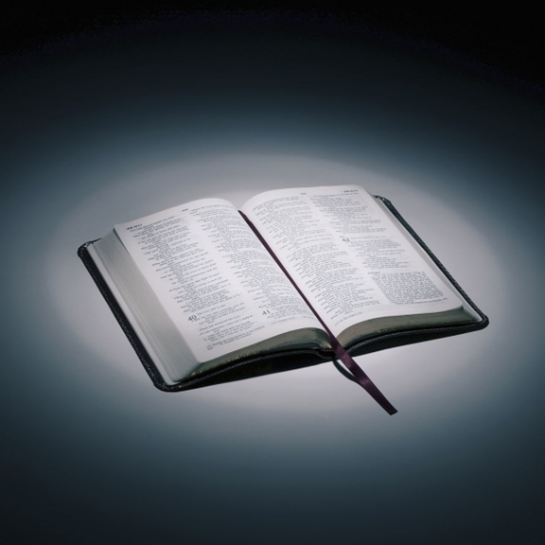
Bible reading

Slide 34
James 1:1-18
James, a servant of God and of the Lord Jesus Christ,
To the twelve tribes scattered among the nations:
Greetings.
² Consider it pure joy, my brothers and sisters, whenever you face trials of many kinds,

Slide 35
James 1:1-18
³ because you know that the testing of your faith produces perseverance. ⁴ Let perseverance finish its work so that you may be mature and complete, not lacking anything.

Slide 36
James 1:1-18
⁵ If any of you lacks wisdom, you should ask God, who gives generously to all without finding fault, and it will be given to you. ⁶ But when you ask, you must believe and not doubt, because the one who doubts is like a wave of the sea, blown and tossed by the wind.

Slide 37
James 1:1-18
⁷ That person should not expect to receive anything from the Lord. ⁸ Such a person is double-minded and unstable in all they do.

Slide 38
James 1:1-18
⁹ Believers in humble circumstances ought to take pride in their high position. ¹⁰ But the rich should take pride in their humiliation—since they will pass away like a wild flower.

Slide 39
James 1:1-18
¹¹ For the sun rises with scorching heat and withers the plant; its blossom falls and its beauty is destroyed. In the same way, the rich will fade away even while they go about their business.
¹² Blessed is the one who perseveres under trial because, having stood the test, that person will receive the crown of life that the Lord has promised to those who love him.

Slide 40
James 1:1-18
¹³ When tempted, no one should say, “God is tempting me.” For God cannot be tempted by evil, nor does he tempt anyone; ¹⁴ but each person is tempted when they are dragged away by their own evil desire and enticed.

Slide 41
James 1:1-18
¹⁵ Then, after desire has conceived, it gives birth to sin; and sin, when it is full-grown, gives birth to death.
¹⁶ Don’t be deceived, my dear brothers and sisters.

Slide 42
James 1:1-18
¹⁷ Every good and perfect gift is from above, coming down from the Father of the heavenly lights, who does not change like shifting shadows. ¹⁸ He chose to give us birth through the word of truth, that we might be a kind of firstfruits of all he created.

Slide 43
Announcements

Slide 44





Account name: Blacktown Chinese Christian Church
Account number: 4216 50263
Offering
BSB: 112 - 879
Please put in "offering" as the reference
The offering box is available at the back of the hall

Slide 45
Prayer points

Slide 46
Mingle time!

